Slide 1
Challenges and Best Practices in Adult Vaccination
Dr. Daniel Stamboulian

Slide 2
Faculty Disclosure
Dr. Stamboulian works occasionally as speaker for Merck, Novartis, Pfizer and Sanofi Pasteur
Dr. Stamboulian is member of the Advisory Board on Adult Immunization for Merck

Slide 3
Burden of Vaccine-Preventable Diseases in USA
Disease | Burden of Illness
Influenza | 12,000 to 80,000 deaths and 140,000 to 900,000 hospitalizations annually; over $10 billion in costs.
Pertussis | 15,800 cases annually.
Pneumococcal disease | Pneumonia 900,000 cases and 400,000 hospitalizations Invasive diseases 35,000 cases, 4,200 deaths)
Zoster | ± 1 million cases/year
https://www.cdc.gov/flu/about/disease/burden.htm
https://www.cdc.gov/pertussis/downloads/pertuss-surv-report-2017.pdf
https://wwwn.cdc.gov/nndss/conditions/invasive-pneumococcal-disease/case-definition/2017/
https://www.cdc.gov/shingles/hcp/clinical-overview.html

Slide 4
Pneumonia

Slide 5
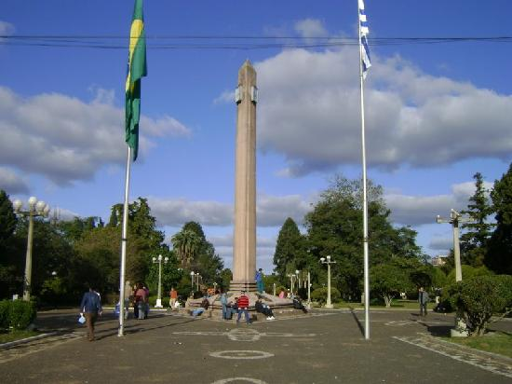
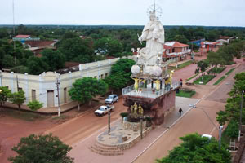
Burden of Community-acquired Pneumonia in Adults, in Southern-Cone America
General Roca, Argentina
Rivera, Uruguay
Concepción, Paraguay

Slide 6
Mortality associated with CAP in adults
 | Global | ≥65 años
Mortality at 14-days | 12.1% | 18.8%
Mortality at 1-year | 24.9% | 35.9%
Lopardo GD, Fridman D, Raimondo E, et al
Incidence rate of community-acquired pneumonia in adults: a population-based prospective active surveillance study in three cities in South America
BMJ Open2018;8:e019439. doi: 10.1136/bmjopen-2017-019439

Slide 7
Antipneumococcal vaccines
Vaccines
Polysaccharide
Conjugate
Effective against 23 types of pneumococcal bacteria
Effective against 13 types of pneumococcal bacteria
Dra. Hebe Vázquez

Slide 8
Vaccination in Adults
CONJUGATE 13-VALENT VACCINE + POLYSACCHARIDE 23-VALENT VACCINE

Slide 9
Herpes Zoster

Slide 10
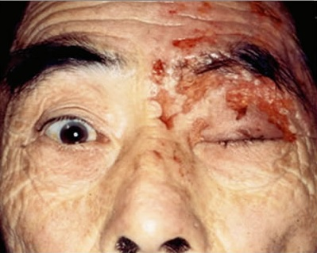

Slide 11
Burden of Herpes Zoster
1 in 3 people will develop Herpes Zoster.
More frequent in women than in men.
https://www.cdc.gov/spanish/especialescdc/culebrilla/index.html

Slide 12
Herpes Zoster: Complications
Postherpetic Neuralgia:
Persistence of pain > 90 days after beginning rash.
Incidence: 10% - 50%
Casado Jiimenez M. Actas Dermosifiliogr 2006;97(S1):9-16
Cohen JI. N Engl J Med 2013;369:255-63

Slide 13
Herpes Zoster Vaccine
Indication: to prevent herpes zoster and postherpetic neuralgia in adults ≥ 50 years.
Approved in Argentina in 2013 and available since August 2014.
Fuente: Disposición ANMAT Nº 1850/2013. http://www.anmat.gov.ar/boletin_anmat/marzo_2013/Dispo_1850-13.pdf

Slide 14
Vaccines for Pregnant Women
Flu
Flu Vaccine
In each pregnancy
In autumn-winter
Pertussis and Tetanus
Tdap
In each pregnancy
From 20 weeks of pregnancy.

Slide 15
Evidence for Vaccination of Older Adults
Flu vaccine reduces hospitalizations, mortality and antibiotic prescriptions in older adults (Nichol N Engl J Med 2007;357:1373-81. )
Pneumococcal vaccines prevent IPD and pneumonia in elderly
(Jackson N Engl J Med 2003;348:1747-55; CAPITA)
Herpes Zoster vaccine reduces incidence and severity of the disease
(Oxman N Engl J Med 2005;352: 2271-84)

Slide 16
Vaccination is Cost Effective
Influenza, pneumococcal and herpes zoster vaccines are cost effective in older adults.
(Nichol, Vaccines 2003; 21: 1769–1775)
(Smith, Am J Prev Med. 2013;44:373-81 )
(Rothberg, Clin Infect Dis. 2007; 44: 1280-88)

Slide 17
The Problem
Infections are a leading cause of morbidity and mortality in the elderly.
Low vaccination rates in this population.

Slide 18
Low vaccination rates: Barriers to Adult immunization
Adults:
Are not aware of the risk or severity of some common vaccine-preventable diseases
Ignore the importance of vaccination
Rarely make preventive care visits
Physicians:
Are not aware of the risk or severity of some common vaccine-preventable diseases
Do not recommend vaccines to their adult patients
Lack information about the effectiveness of vaccines

Slide 19
What We Do
Immunization campaigns
Immunization centers
Healthcare Professionals Education
Community Education
Research

Slide 20
Immunization Centers

Slide 21
6 Vaccination Centers in BA City

Slide 22
Doses administered 2010/2015
Total: 1.559.652

Slide 23
Healthcare Professionals Education

Slide 24
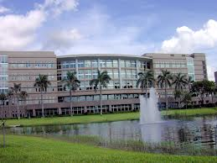
Healthcare Professional Education
Hospitals
Universities
Pharmacies

Slide 25
Community Education

Slide 26
Community Education
Printed Material
Press Campaigns
Magazines: Reflexiones and other publications
TV and radio programs: A Ciencia Cierta, interviews

Slide 27
Research
More than 30 years engaged in research
Epidemiological studies
60 clinical trials (phase II, III and IV) in vaccines

Slide 28
Future Challenges
Increase vaccination rates in adults
Expand opportunities for individuals to receive vaccination
Improve healthcare professionals´ engagement in promoting immunizations
Strengthen communication on the benefits of vaccination

Slide 29
Thank you
dstamb@stamboulian.com.ar

